Slide 1
Mahatma gandhi

Slide 2
Info about gandi
Where he was born:Porbandar, india
date of birth: 2 October 1869
Job: lawyer

Slide 3
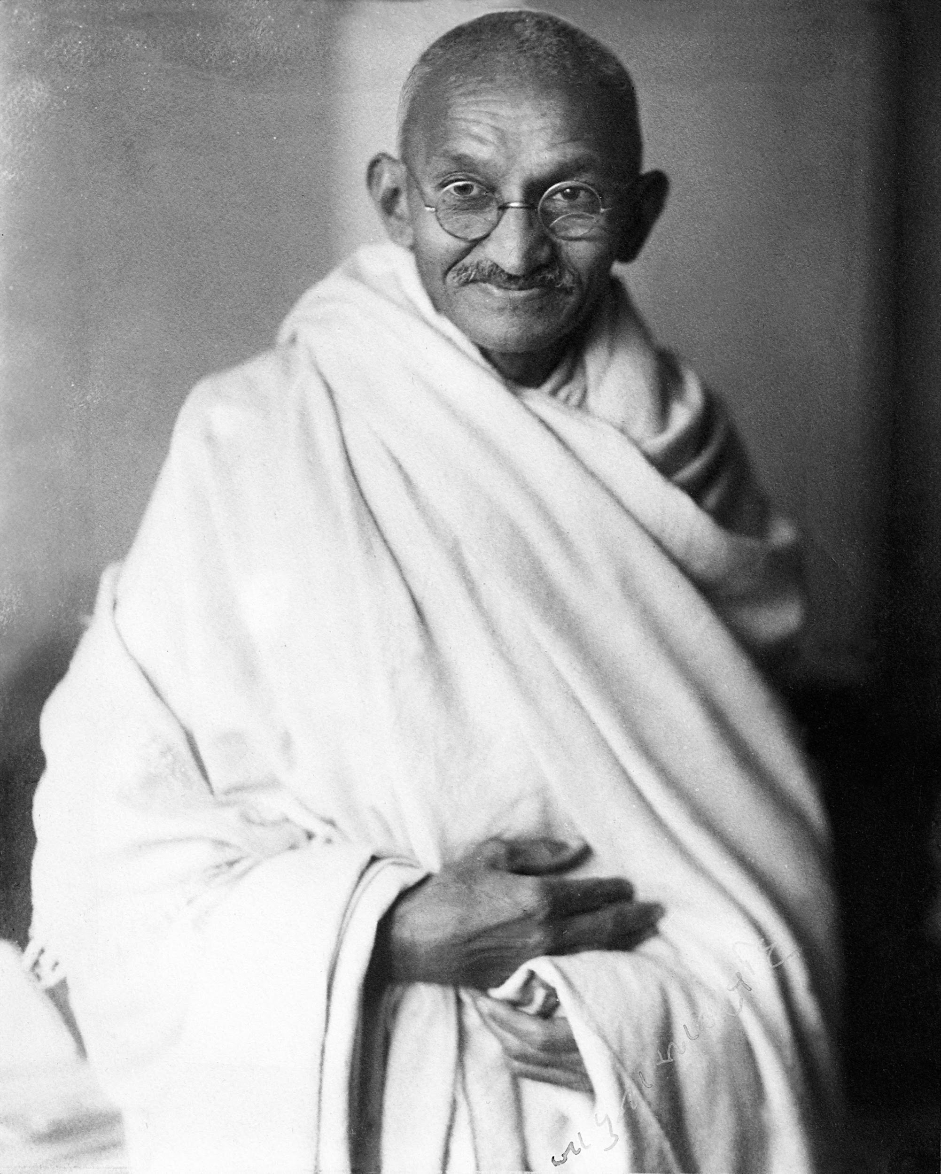
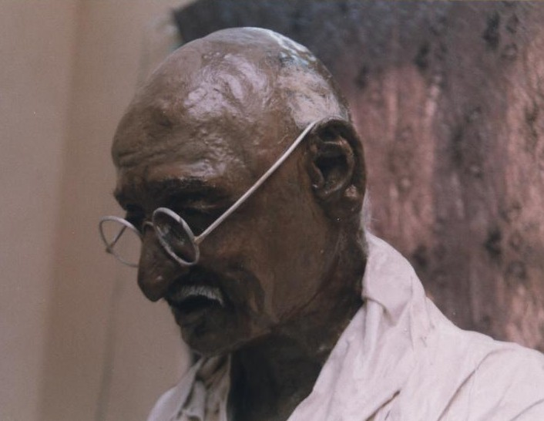

Slide 4
Video about gandi
https://youtu.be/1pR8HO6Vb3M

Slide 5
Why is gandi famous? What did he do?
Gandhi is most famous for his philosophy of nonviolence that has inspired civil rights leaders around the world. And he had a belief that black and white people should have equal rights, and be looked upon the same as every other person.
Gandi believed in equality. Equality means to treat people the same.

Slide 6
3 interesting facts about gandi.
The United Nations declared Gandhi's birthday, October 2nd, as the International Day of Non-violence in 2007
.
Gandhi Ji set up a small colony, Tolstoy Farm at an 1100 acre site, 21 miles from Johannesburg, South Africa for his colleagues in the Satyagraha struggle.
Do you know how many times Mahatma Gandhi was nominated for the Nobel Peace Prize? Gandhi ji was nominated in 1937, 1938, 1939, 1947, and, finally, a few days before he was murdered in January 1948.

